Slide 1
Software Engineering
Lesson 1 – Requirements – Types and Characteristics
LO2 : Carry out a requirements acquisition exercise in order to identify the main functional and non-functional requirements of a proposed software system

Slide 2
Lesson Objectives
Understanding the Different Types of Requirements.
Business Requirements
System Requirements
Functional Requirements
Non-Functional Requirements
Characteristics of a Good Requirement
Correct
Unambiguous
Complete
Consistent
Ranked
Verifiable
Modifiable
Traceable

Slide 3
What is a Requirement?
Definition:
“A description of the needs and desires for an information system.
A requirement may describe a function, a feature (attribute), or constraint.”
Requirements are a crucial part of systems development as they help us build the system that the client needs and check whether the system works correctly.
In agile methodologies, requirements identification and confirmation are a continuous process that involves constant communication between all members of the development team and major stakeholders.

Slide 4
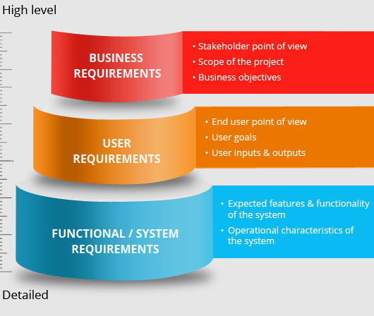
Different Types of Requirements
All Requirements describe
What the System Should Do
BUT
Different Requirements describe Different Aspects of the System
IN
Different Levels of Detail

Slide 5
Different Types of Requirements
Requirements may be categorized as follows:
Requirements
System
Functional
Non-Functional
Business

Slide 6
Different Types of Requirements
Business Requirements
High-level, generic objectives or goals of what the system should achieve.
Do not specify in what way the system will function to achieve targets.
Example :
“Implement a computerized system to introduce e-commerce to the business”.
A business requirement is usually defined in such a way that it is easily understood by top level managers and directors who may have a non-technical background.

Slide 7
Different Types of Requirements
System Requirements
A listing of the functionality the system is expected to provide to achieve business requirements i.e. they define what needs to be delivered.
Agreed in conjunction between representatives of the developers and stakeholders.
Example :
“Implement a shopping cart allowing users to purchase products. Cart details should include all product details, the quantity to be purchased and a link to the customer’s account”.
System Requirements can be further sub-categorized into :
Functional Requirements and Non Functional Requirements

Slide 8
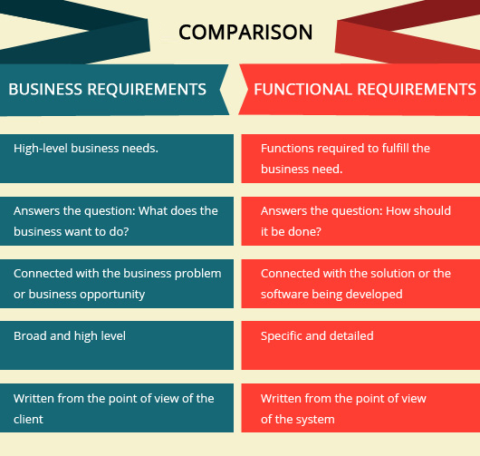
Different Types of Requirements

Slide 9
Different Types of Requirements
Functional Requirements
Define ‘WHAT’ a system is expected to do but not HOW it should do it.
Related to actions and behaviors that the system is expected to perform
Include the functions and services that must be included in the system in order to satisfy the business needs and for the system to be acceptable to the users.
Example :
“The system shall provide the user with an easy to browse through product list”
A general rule of thumb is to think in terms of “the system shall” statements.
In Agile Development, many Functional Requirements are written as User Stories, hence one must think on terms of “As a user I shall be able to….” statements

Slide 10
Different Types of Requirements
Non Functional Requirements
Focus on the overall perception of the system’s behavior and operation i.e. how well it carries out the Functional Requirements
Define standards, characteristics and attributes of the system.
Very often related to targets for performance, security, user friendliness, load, etc.
Cannot be necessarily described as actions that the system must perform.
Example :
“The system is expected to be available 24/7. Downtime should be kept to a maximum of two hours per month for database backup”
Non Functional Requirements can be further sub-categorized.

Slide 11
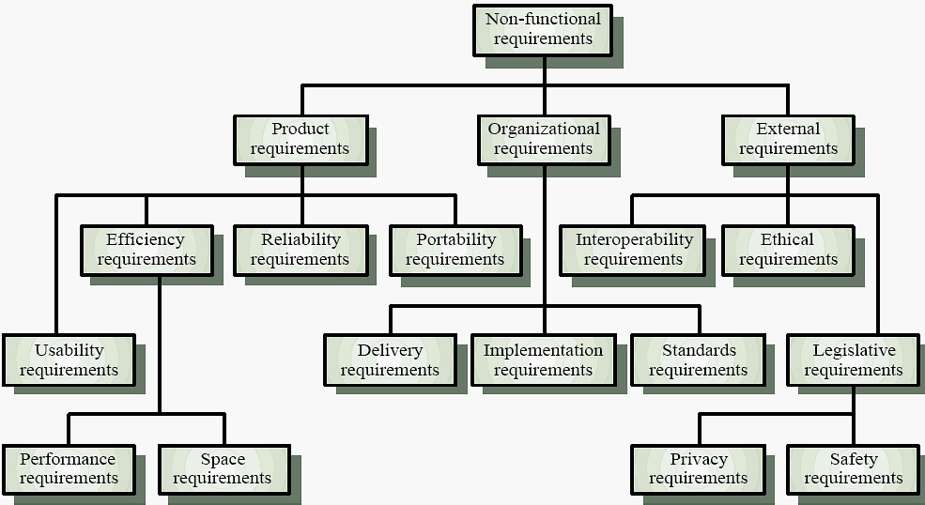
Different Types of Requirements
Further Classification of Non Functional Requirements

Slide 12
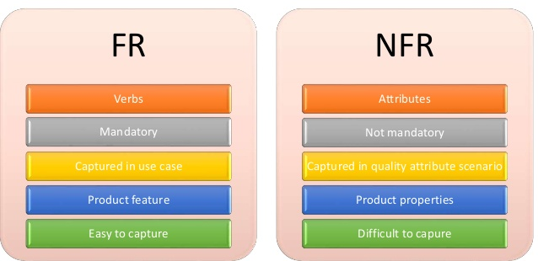
Different Types of Requirements
Comparison of Functional Requirements with Non Functional Requirements

Slide 13
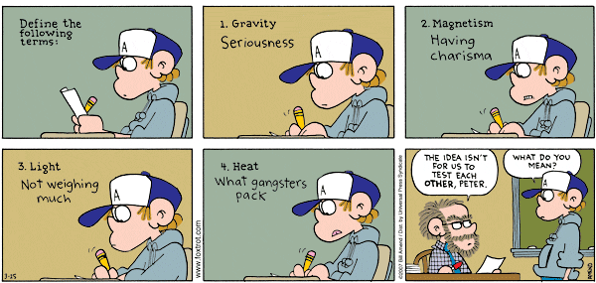
Characteristics of Good Requirements
Writing a good set of requirements is not an easy task and should not be taken lightly!
Why?

Slide 14

Brain Storimg Session
What Makes a
Good Requirement?

Slide 15
Characteristics of Good Requirements
In order for requirements to be considered as correctly specified, they be:
Consistent
Requirements are not conflicting with each other or unclear to any stakeholder.
Complete
Requirements describe all possible system inputs and responses.
Feasible
Requirements can be satisfied based on the available resources and within the limits of any given constraints including schedule, budget and technology.
Required
Requirements are truly needed and fulfill the purpose of the system i.e. they must be in line with the aim and objectives identified at the start of the project.

Slide 16
Characteristics of Good Requirements
In order for requirements to be considered as correctly specified, they be:
Accurate
Requirements are stated correctly and mean only one thing!
Traceable
Requirements can be directly mapped to the functions and features of the system. Requirements should also trace links between dependent requirements .Good Requirement Traceability should enable a requirement to be traceable back to the reasons why it was included in the system and who proposed it.
Verifiable
Requirements are defined so they can be demonstrated during testing i.e. it can be proven via a series of test cases that this requirement has been achieved and that it works correctly. This might be harder to do for non-functional requirements.
Notes:
http://www.slideshare.net/guest24d72f/8-characteristics-of-good-user-requirements-presentation

Slide 17
End of Lesson 1
Any questions?

